Slide 1

ENGINEERING PHYSICS
Subject Code: UBSL101/UBSP101
TERM – I
Academic Year: 2020-21

Slide 2
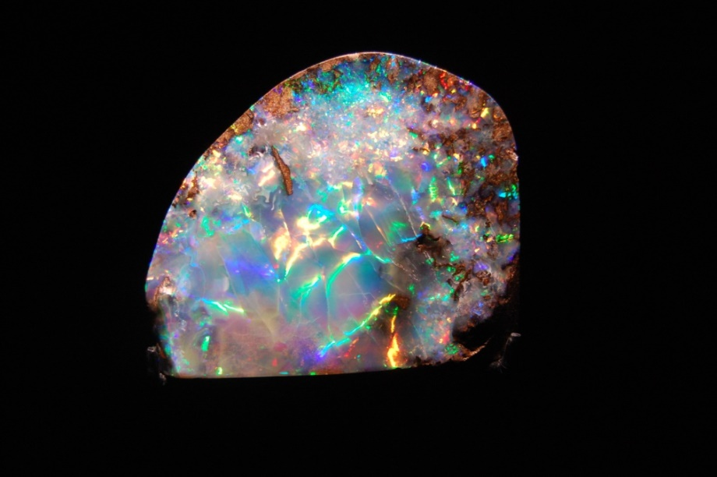
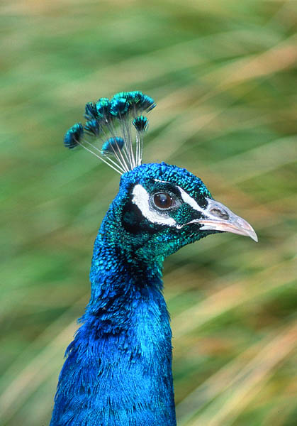
UNIT – II: OPTICS
Optics:
Interference-Interference in uniform & non-uniform thin films
AR Coatings
Surface Testing
Branch specific applications
Optics: physics of light
different layers of understanding/describing light

Slide 3
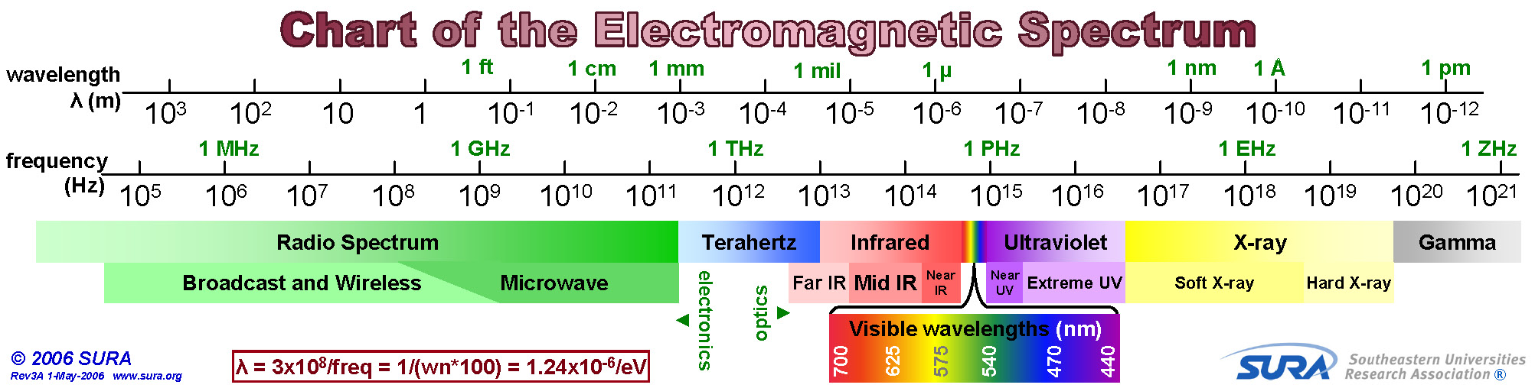
Reminder:
Visible light is a small part of the electromagnetic spectrum.
Wavelenths of visible light: 400 nm (violet) to 700 nm (red)

Slide 4
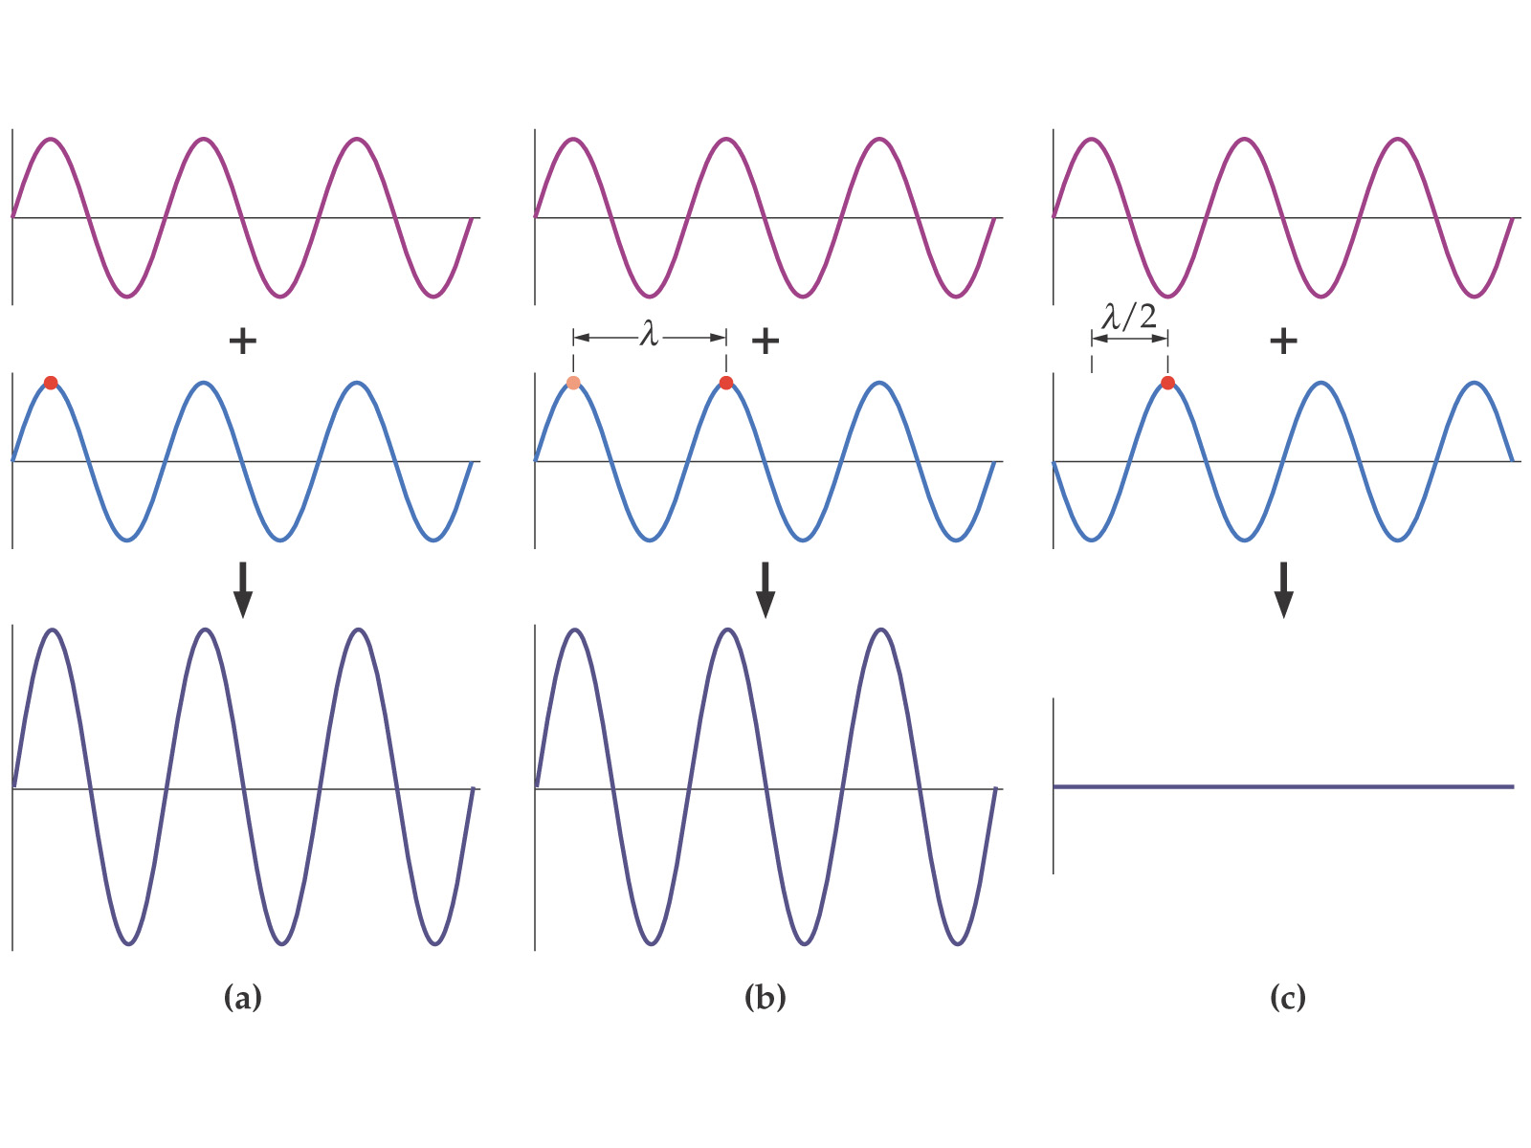
Superposition and Interference
If two waves occupy the same space, their amplitudes add at each point. They may interfere either constructively or destructively.

Slide 5
Conditions for Interference
The following four conditions must be true in order for an interference pattern to be observed.
The source must be coherent – has a constant phase relationship
Wavelengths must be the same –monochromatic
The Principle of Superposition must apply
The waves have the same polarization state

Slide 6
Constructive & Destructive conditions:
When you combine two (or more) waves, you need to know the phase shift between them:
The angle φ is the phase shift
When the phase shift is zero, the waves add constructively
The result is bigger
Same thing for any even multiple of 2π
When the phase shift is π, the waves add destructively
The result is smaller
Same thing for any odd multiple of π
To find maximum/minimum effects, set phase shift to even/odd multiples of π

Slide 7
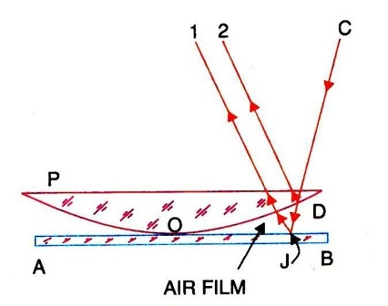
Methods of Interference
Interference of waves occurs when waves overlap. There are
two ways to produce an interference pattern for light:
Division of amplitude (Ex. Thin Film)
Division of wavefront (Ex. Young’s Experiment, Biprism)
Both of these involve splitting the light from a single source into
two beams.
Division of amplitude
This involves splitting a single light beam
into two beams, a reflected beam and a
transmitted beam, at a surface between
two media of different refractive index.

Slide 8
Interference in uniform Thin Film:
180° phase change
❶
❷
Ray ❶ undergoes a phase change on reflection.
No phase change
Air
Ray ❷ does not undergo a phase change on reflection..
Film
t
n_{Air}< n_{Film}
Air
Do the reflected rays ❶ and ❷ interfere destructively or constructively?
Caution! The wavelength in the film is different than in air.
Dark lines in drawings are there to help you see the boundaries, and are not a separate medium.

Slide 9
Assume the incident light is nearly perpendicular to the film surface.
The path length difference is approximately 2t.
180° phase change
No phase change
Air
There is a 180° phase difference (½ of a wavelength) due to the first reflection.
Film
t
n_{Air} < n_{Film}
Air
We will get destructive interference when the path difference is an integral number of wavelengths:

Slide 10
Assume the incident light is nearly perpendicular to the film surface.
We get constructive interference when the path difference is λ_{film}/2, 3λ_{film}/2, 5λ_{film}/2, etc.
180° phase change
No phase change
Air
Film
t
n_{Air} < n_{Film}
Air
We will get constructive interference when the path difference is a half-integral number of wavelengths:

Slide 11

Conditions for Bright and Dark Rings:
The optical path difference between the rays is given by
But, for air and for normal incident
Therefore,
For maxima ,the optical path difference
It is equal to an integral number of full waves, then the rays meet each other in phase. The crests of one wave falls on the crests of the other and the waves interference constructively.

Slide 12


Contd….
Therefore, or
This is the condition for obtaining bright fringe
The minima occur when the optical path difference is
The optical path between the two rays is equal to an odd integral number of half-waves, then the rays meet each other in opposite phase . The crest of one wave fall on the troughs of the other and the waves interfere destructively

Slide 13
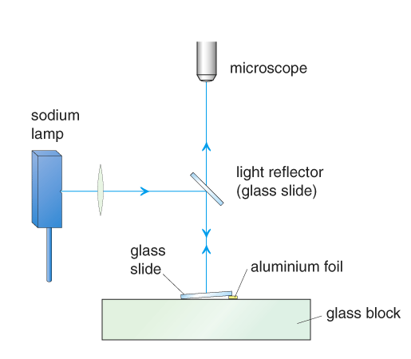
Wedge-shaped air film (Non – uniform)
Fringe Pattern
air wedge between glass slide and glass block

Slide 14
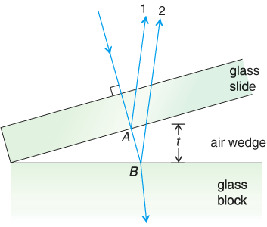
Wedge-shaped air film
ray 2 reflected (phase change of π)
ray 1 reflected (no phase change)
Note: When m = 0, it gives rise to the first dark fringe.

Slide 15
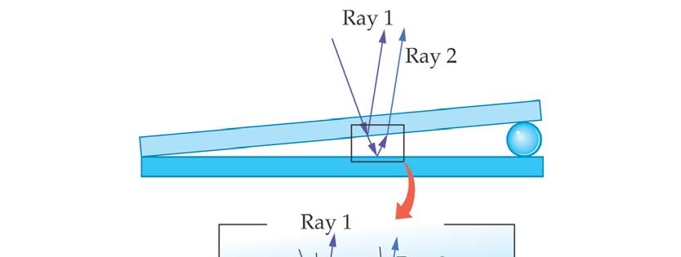
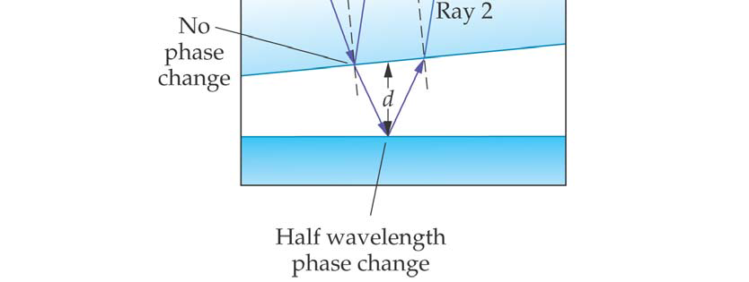
Note: 1. The fringe separation is proportional to wavelength.
2. If white light is used, colour fringes will be observed. Red light is further apart as its wavelength is longer.
3. If the angle θ is too great, the fringes will be too close that no interference is observed.

Slide 16
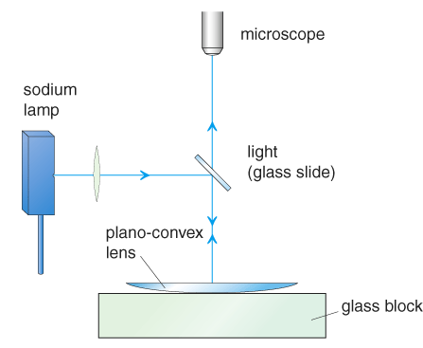
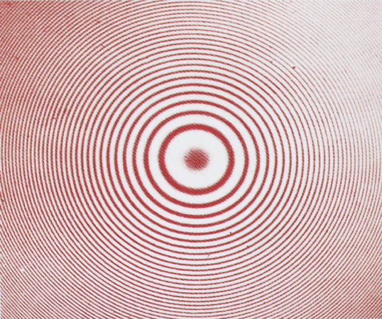
Newton’s ring
Fringe Pattern
air wedge between lens and glass block

Slide 17
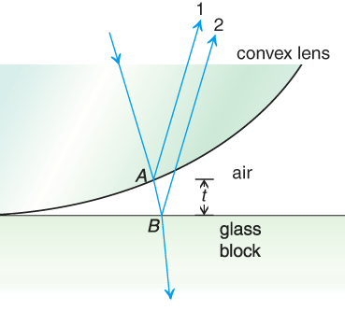
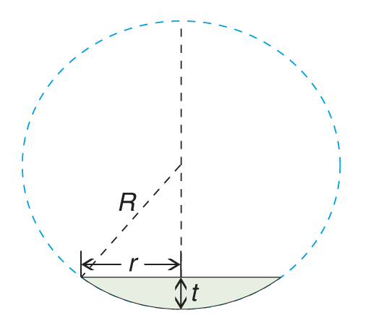
Newton’s ring
ray 1 reflected ( no phase change)
ray 2 reflected (phase change of π)
For dark rings
r² = mRλ

Slide 18
Important Points
By , as the thickness of the air film increases gradually outwards non-uniformly, the separation between the fringes decreases.
If white light is used, coloured rings will be observed. For a given ring, the inner side is violet and outer side is red. This is because the radius is proportional to the square root of wavelength and red light has longer wavelength.
It is a dark spot at the centre of the lens. The path difference of the
two reflected light is zero, but there is a 180°phase change on ray
Therefore, an half wavelength path difference exists between the
two rays. Thus, destructive interference occurs at centre.

Slide 19
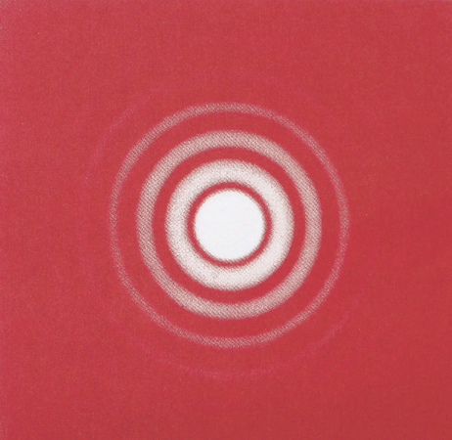
Important Points
If the interference pattern is viewed from below the glass block, reversed bright and dark fringes will be observed, i.e. the centre becomes a bright spot. This is because of the two 180°phase changes due to the ray reflected twice by an optically denser medium. Thus, the transmitted rays are in phase.
As the rings produced by the transmitted light are complementary to that by the reflected light, i.e. constructive interference on one side of
the film while destructive interference on
the other side, it shows that energy is
conserved.

Slide 20
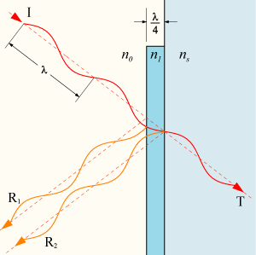
Application: Anti-Reflective Coatings
Your eyeglasses (possibly) and sophisticated multi-element optical systems like telephoto lenses (definitely) rely on anti-reflective coatings to reduce extraneous images, loss of contrast, and other image degradation due to unwanted reflections.
Straightforward application of thin-film interference:
Coating of SiO, MgF₂ or other. Hard, transparent, and easy to apply in a thin uniform coating (e.g. by vapor deposition).
n_{air} < n_{coating} < n_{glass} – two phase jumps
Thickness λ/4 for best transmission (destructive interference for reflection) where λ is the wavelength in the film.
Explicitly, λ_{film}=λ_{air}/n
Single-layer coating optimized for one wavelength, typically ~550 nm (yellow/green). Visible color in white light is white-yellow/green ≅ purple

Slide 21
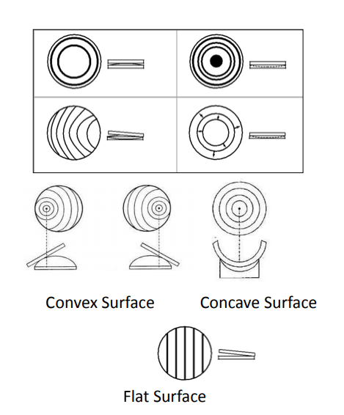
Surface Testing
Checking of flatness using optical flat
A perfectly flat surface will show straight and evenly spaced bands.
A convex surface displays a bright patch in the center, while a concave surface displays a dark patch in the center of the pattern.
Testing Using Finger Pressure:
Convex: If and edge is subjected to pressure, the flat will roll about the apex
Concave: If light pressure is applied at the center, fringes move outward and reduce in number.

Slide 22
Branch specific applications
Electromagnetic – Wave approach (Electronics & Telecommunication)
Photoelasticity effect (Electronics & Telecommunication)
Digital Image Correlation (Electronics & Telecommunication)
Fiberoptic Sensors (Electronics & Telecommunication)
Metamaterials (Mechanical Engineering)
Non-destructive detection
Spectrum measurement
Monitoring of civil infrastructure using Fiber optics sensors (Civil Engineering)
Optical computing (Computer Engineering/IT)

Slide 23

Any Questions ?

